Slide 1
Performance Based Navigation in USA
Program Status and Processes
ICAO Asia and Pacific Region Performance Based Navigation (PBN) Seminar
Nick Tallman
8-10 June 2015

Slide 2
Overview
PBN Program Background
Current Status and Implementation Processes
Delivering New Capabilities with PBN

Slide 3
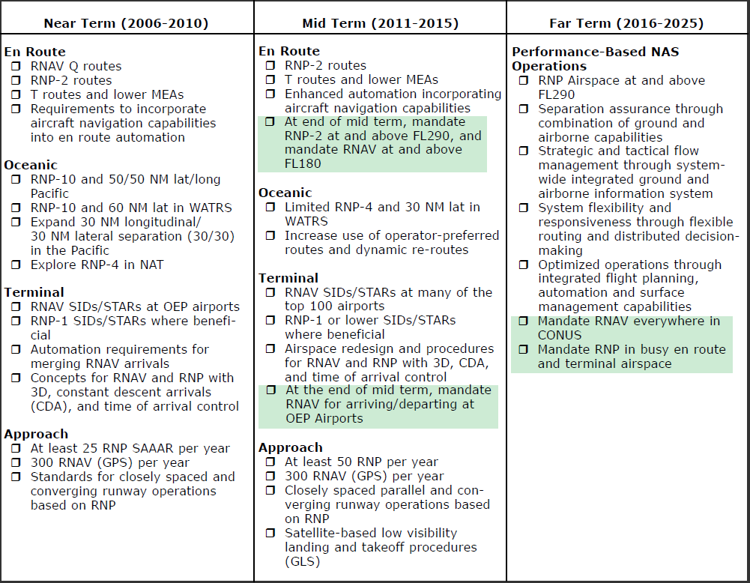
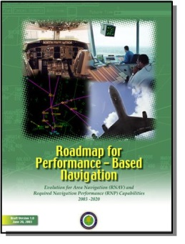
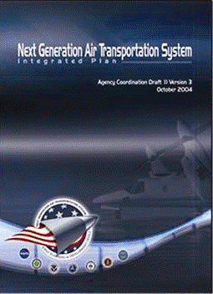

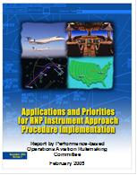
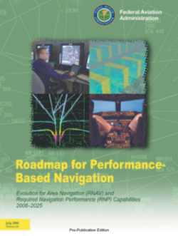
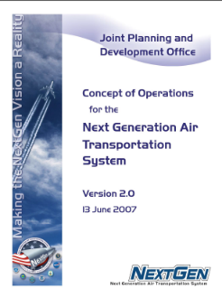


PBN Roadmap (2006) – What’s been accomplished?
Proposed Mandates
Operationally available
In progress

Slide 4

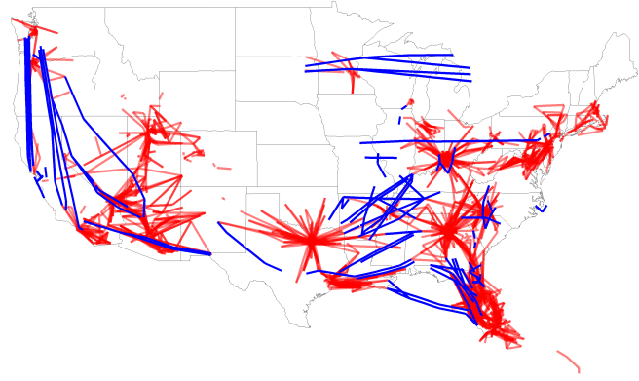

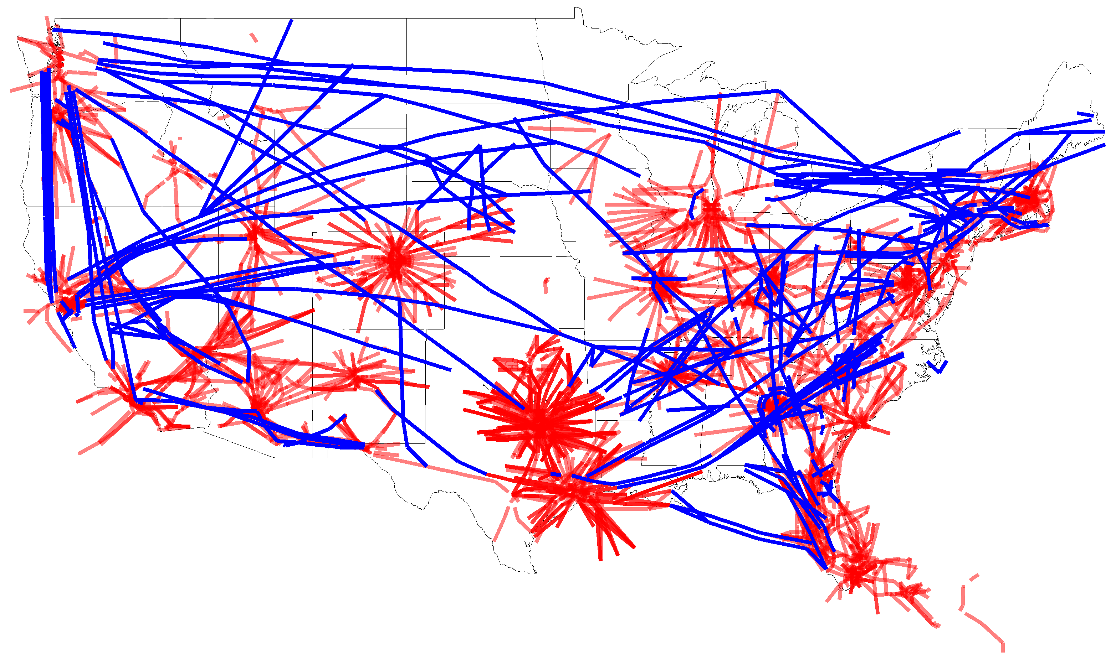
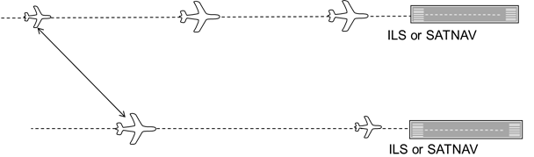

PBN Accomplishments
More than double PBN procedures since 2009
Of Public Airports with published IAP:
2009
98%
25%
2014
175
416
2,321
4,648
137
384
45
122
28
61
100
309
have a PBN IAP
with only PBN IAP
RNAV STARs
RNAV SIDs
RNAV/RNP Approaches
RNP-AR Approaches
Q-Routes
T-Routes
Oceanic separation standards reduced with RNP
RNAV SIDs and STARs at over 80% of ASPM77 airports
2009
50nm
2009
SIDs/STARs
Q/T-routes
2014
50nm
152
30nm
30nm
2014
New Optimized Profile Descent (OPD) RNAV STARs
>3,600 ft
2009
2014
>4,300 ft
Capable with ILS or LNAV/VNAV, RNP, RNP AR, GLS, and LPV
Capable with ILS or SATNAV
Reduced, separation standards for closely-spaced approaches
Notes:
The last decade has seen a number of accomplishments in the area of PBN (click mouse)
The number of SIDs, STARs, Q-Routes and T-Routes has grown across the NAS. In fact, we now have RNAV SIDs and STARs at over 80% of the ASPM 77 airports. This growth in PBN includes the implementation of 152 new arrival procedures with Optimized Profile Descent, improving efficiency and reducing fuel burn for both the user community and the environment. (click mouse)
In the past, the efficiency gains of independent runway operations would have required investing in new concrete, the application of closely-spaced parallel operations has enabled more airports to use their existing runways independently and improve efficiency without the capital investment of a new runway (click mouse)
RNP procedures have enabled reduced separation standards in the oceanic airspace. Routes that previously required 50 nm for safe separation now only require 30nm. This allows more flights to transit their preferred routes at their preferred times
The key goal over the last decade has been to propagate PBN procedures and capabilities across the National Airspace System. We’ve done just that (click mouse)
Just in the 5 years from 2009 to 2014, PBN procedures have more than doubled. (mouse click) Today we have three times the number of RNAV STARs (mouse click) Over double the RNAV SIDs (mouse click) Twice as many RNAV/RNP approaches (mouse click) three times the RNP-AR approaches (mouse click) close to the three times the number of Q-routes (mouse click) and double the T-routes. In fact (mouse click) of the airports that have Instrument Approach procedures, 98% have a PBN procedure. 25% of these airports operate with PBN as their only IAP capability.
We’ve accomplished many of the objectives identified in the 2006 PBN Roadmap.

Slide 5

Performance Based Navigation (PBN)
Current Status as of: March 2015
RNAV SIDs | 523
RNAV STARs | 329
RNP | 387
Airports | 457
Airport with STAR
Airport with SID
Airport with RNP
SIDs and STARs are RNAV 1 Navigation Specification
RNPs are instrument approach procedures with RNP Authorization Required (AR) APCH Navigation Specification

Slide 6


Airports with RNAV (GPS) Approaches Including LP/LPV Minima
As of: February 2015
4,109 LP/LPVs combined
3,523 LPVs serving 1,731 Airports
908 LPV-200’s
2,385 LPVs to Non-ILS Runways
1,138 LPVs to ILS runways
1,630 LPVs to Non-ILS Airports
586 LPs serving 426 Airports
583 LPs to Non-ILS Runway
3 LPs to ILS Runways
Navigation Specification is RNP APCH (non-AR)
Localizer Performance (LP) or Localizer Performance with Vertical guidance (LPV) minima are often include with other options for final on charts, including Barometric Vertical Navigation (VNAV)

Slide 7

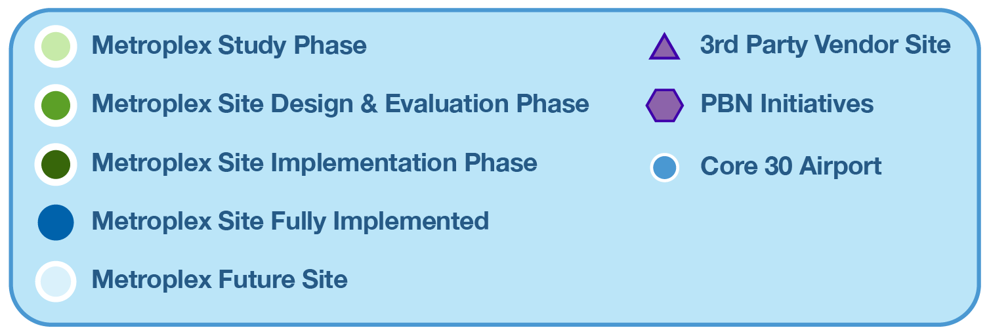
Performance Based Navigation (PBN)
Current Status as of: March 2015

Slide 8
Metroplex Site Timeline/Phase Description
Study Team
Study Team
Design and Implementation Team
Design and Implementation Team
Eval Phase
Operational,
Study
Study
Design and
Design and
Implementation
Implementation
Post
Post
-
Implementation
and
Implementation
and
Procedure
Procedure
Environmental,
Environmental,
and
and
Review and
Scoping
Review and
Scoping
Development
Development
and SMS Review
and SMS Review
Training
Training
Modifications
Modifications
Key Decision Points
Key Decision Points
Scope of effort
Scope of effort
90% designs
90% designs
Preferred design
Preferred design
Implementation
defined
Implementation
defined
developed
developed
determined
determined
completed
completed
Study and Scoping: The Study Phase is conducted by study teams that identify issues and propose potential solutions through facility and industry interface meetings. Industry representation is achieved with lead carrier representatives. The result of this phase is a set of conceptual designs, with a high-level assessment of benefits, costs, and risks.
Design and Procedure Development: The Design Phase is where the detailed Integrated Airspace and Procedures design work is conducted. The work conducted in this phase uses the results of the study teams and is conducted by a D&I team. Industry representation is achieved with lead carrier representatives. When appropriate and justified, on-site Human-in-the-Loop (HITL) simulations and other design analyses may be part of this phase.
Evaluation: The Evaluation Phase is the second stage conducted by the D&I team. It includes all necessary operational modeling, Safety Management System (SMS) analyses, and environmental reviews. Industry representation is achieved with lead carrier representatives. If analyses are conducted during the Design Phase, they may feed into the Evaluation Phase.
Implementation and Training: The Implementation Phase is the last part of the OAPM process conducted by the D&I team. This phase includes all steps required for implementation of the OAPM project including flight inspections, publishing procedures, planning and executing training. Industry representation is achieved with lead carrier representatives.
Post Implementation Review and Modifications: The Post-Implementation Phase includes a review of the implemented airspace and procedures changes to determine if they have delivered desired benefits and/or caused other impacts. Modifications or refinements may be made to better achieve desired benefits or address unforeseen impacts.
Notes:
Study Team looks at Metroplex from outside using non-site personnel
Design Team uses SMEs and POCs from the sites

Slide 9


Metroplex Project Example: Northern California
Implemented: 16 RNAV STARs, 19 RNAV SIDs, 1 Conv. SID, and 8 Q-Routes
Study and Scoping
Design and Procedure Development
Eval Phase
Operational, Environmental, and SMS Review
Implementation and
Training
Post-Implementation Review and Modifications
3/2012
12/2012
27 Months
10 Months
7
RISKS/NOTES:
Chart Dates: 11/13/14, 1/8/15, 3/5/15, and 4/30/15—6 RNAV STARs
EA Kickoff | 4/17 /2012 |  | AJV-114
Phase Start | 1/6/2013 |  | AJV-1
EA Purpose and Need Section | 2/14/2013 |  | AJV-114
EA Alternatives Section | 2/22/2013 |  | AJV-114
Final Ops Validation | 4/5/2013 |  | AJV-121
100% Design Complete | 4/24/2013 |  | AJV-121
SMS Initiate | 4/12/2013 |  | AJV-W
Facilitation SRM Panel | 5/20/ 2013 | 10/31/2013 | AJV-W
EA Affected Enviro Section | 6/7/2013 |  | AJV-114
SMS draft doc. completed | 8/1/ 2013 | 10/30/2013 | AJV-W
EA Enviro Consequences Sect | 8/23/ 2013 | 12/6/2013 | AJV-114
SMS final doc. completed | 8/29/ 2013 | 11/30/ 2013 | AJV-W
SMS Final doc. signed | 12/27/ 2013 | 9/10/2014 | AJV-W
Draft EA | 12/6/ 2013 | 3/12/2014 | AJV-114
SMS Process Complete | 12/27/ 2013 | 9/10/2014 | AJV-W
Final EA FONSI | 3/31/ 2014 | 7/22/2014 | AJV-114
Phase Start | 3/31/ 2014 | 7/28/2014 |  | AJV-1
Impl Plan Complete | 8/22/2014 |  |  | AJV-143
Training Plan Complete | 10/3/2014 |  |  | AJV-143
Implementation Stage 1 | 11/13/14 |  |  | AJV-143
Implementation Stage 2 | 1/8/15 |  |  | AJV-143
Implementation Stage 3 | 3/5/15 |  |  | AJV-143
Final Flight Checks | 3/6/2015 |  |  | AJW-3
Final Stakeholder Coordination | 4/3/ 2015 |  | 4/23/ 2015 | AJV-143
Training Complete | 4/15/ 2015 |  | 4/29/ 2015 | AJV-143
Implementation Stage 4 | 4/30/15 |  |  | AJV-143
Implementation Complete | 4/30/2015 |  |  | AJV-143
Phase Start | 5/1/2015
Analysis Plan & Baseline Performance | 5/29/2015
Initial Ops Implementation Monitoring Complete | 7/3/2015
Data Collection Initiated | 7/31/2015
Analysis Complete and Necessary Mods ID’d | 11/13/2015
Post-Implementation Phase Complete | 12/18/2015
A4A
Core 30
Complete
On Track
May Be Missed
Missed
FY16 or beyond

Slide 10
PBN Implementation Process
FAA Order 7110.41 established a five-phase standardized implementation process
Applies to most PBN procedures and routes
Does not apply to RNAV (GPS) approaches and other national programs
Notes:
The Preliminary Activities phase is where a work group defines and provides justification for a PBN procedure/route project.
The Development Work phase is to generate a single PBN procedure or a set of PBN procedures and routes that are operationally viable, flyable, and suitable for submission for approval and publication.
The Operational Preparations phase of the PBN Implementation Process is to identify any operational items that need to be put in place prior to publishing the procedures or routes.
The Implementation Phase of the PBN Implementation Process is when the routes and/or procedures are implemented as designed.
The Implementation Phase of the PBN Implementation Process is when the routes and/or procedures are implemented as designed.

Slide 11






PBN Reduced Divergence Concept
Equivalent Lateral Spacing Operation (ELSO) Standard
  Capitalizes on improved navigational precision of PBN operations
  Enables reduced-divergence departure operations (surveillance required)
Departure Operations
Today:
Reduced Divergence Benefits
  Procedure design options
  Increased departure efficiency
Conventional
PBN
Lateral spacing
Conventional 15-degree divergence
ELSO:
PBN
Equivalent
Lateral spacing
ELSO divergence with RNAV 1 SIDs

Slide 12
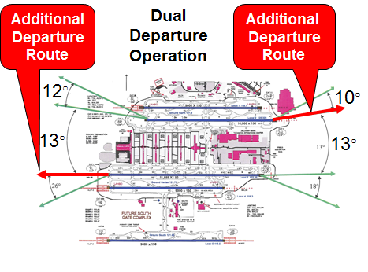
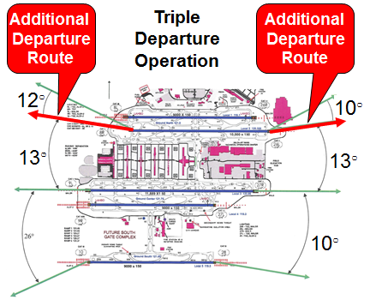
Atlanta (ATL) Implementation
Operational Change
  One additional ELSO-enabled departure path in both East and West operation (Improves both Dual and Triple flows)
Expected Initial Benefit
  $20M for ATL operators

Slide 13
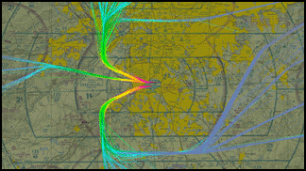

ATL Pre-Implementation of ELSO
13

Slide 14
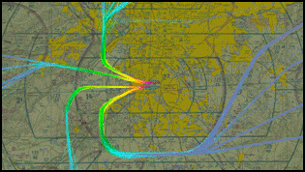

ATL Post-Implementation
14

Slide 15
ELSO National Standard Change
Additional Refinement of Concept Developed for 10 Degree Divergence
Applies to Successive or Simultaneous RNAV SID Departures
Standard Change Effective 25 June 2015
Notes:
Parallel runways separated by 2500 feet or more
RNAV SIDs lateral path construction must begin at Departure End of Runway (DER)
This is in Change 3 to JO 7110.65V; graphics are from amended paragraphs 5-8-3 and 5-8-5

Slide 16
Established on RNP (EoR) Project
Performance Based Operations Aviation Rule Making Committee (PARC) 2011 Report to FAA adopted by NextGen
Initial Focus for Simultaneous Dependent Operations at Seattle (Greener Skies)
Initial Focus for Simultaneous Independent Operations at Denver International Airport
Objective is to Establish Beneficial National Standard Change(s)
Notes:
PARC is an FAA Chartered Government and Industry Advisory Group
“RNP Established” Report Delivered Feb 2011

Slide 17
EoR Concept of Operations
ATC Must Provide 1000 FT Vertical or 3 NM Radar Separation Between Aircraft During Turn On To Parallel Final Approach
Aircraft Must be ‘Established” on the Straight-In before Losing Standard Separation – significant factor forcing extended downwind paths
EoR Allows Aircraft to be “Established” Once on the RNP Procedure
Predictable Path, Reduces Track Miles and ATC/Pilot Communications

Slide 18
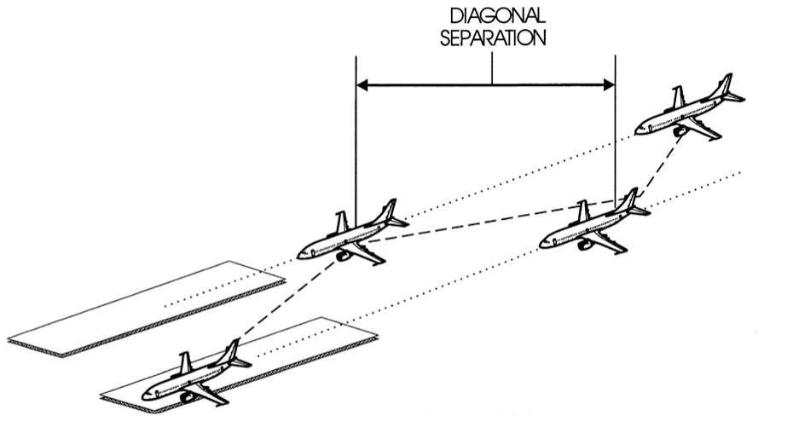
Simultaneous Dependent Approaches
Parallel Straight-In Approaches
1000 Ft Vertical or 3 NM during Turn On
1.5 NM Diagonal Separation with Runway Centerlines 2500 – 4300 feet apart
2 NM Diagonal Separation with Runway Centerlines more than 4300 – 9000 feet
Developmental Site: Seattle (SEA), Washington (Greener Skies project)

Slide 19
SEA Simultaneous Dependent Operations
RNAV STARs Connect to RNP AR Approaches on Downwind (Closed STAR)
Implementation Based on Local Waiver to FAA JO 7110.65, Air Traffic Control
Play Video of First Simultaneous Dependent Operation with EoR flight…

Slide 20
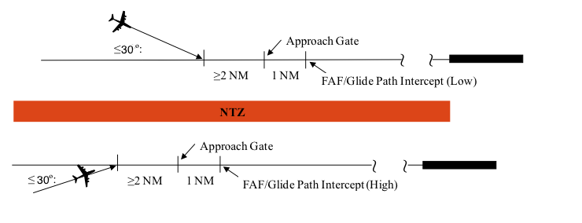
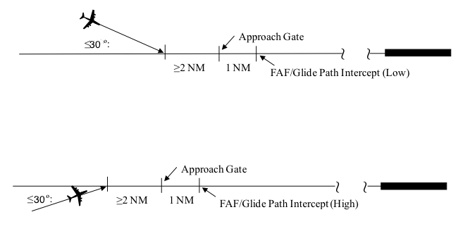
Simultaneous Independent Approaches
Duals, Triples & Widely-Spaced
DUALS & TRIPLES
Parallel Straight-In Approaches
1000ft Vertical or 3NM Lateral Turn On
Radar Final Monitor Required
Non-Transgression Zones (NTZ)
WIDELY-SPACED
Parallel Straight-In Approaches
1000ft Vertical or 3NM Lateral Turn On
More than 9000ft between runways
Radar Final Monitor NOT Required
Developmental Site: Denver (DEN), Colorado

Slide 21
DEN Simultaneous Widely Spaced Operations
RNAV STARs Connect to RNP AR Approaches on Downwind (Closed STAR)
Implementation Based on Local Waiver to FAA JO 7110.65, Air Traffic Control
Play Video of DEN Widely-Spaced Simultaneous Independent Approaches, Without Final Monitors, Showing First EoR Flights with Graphical Description Overlays

Slide 22
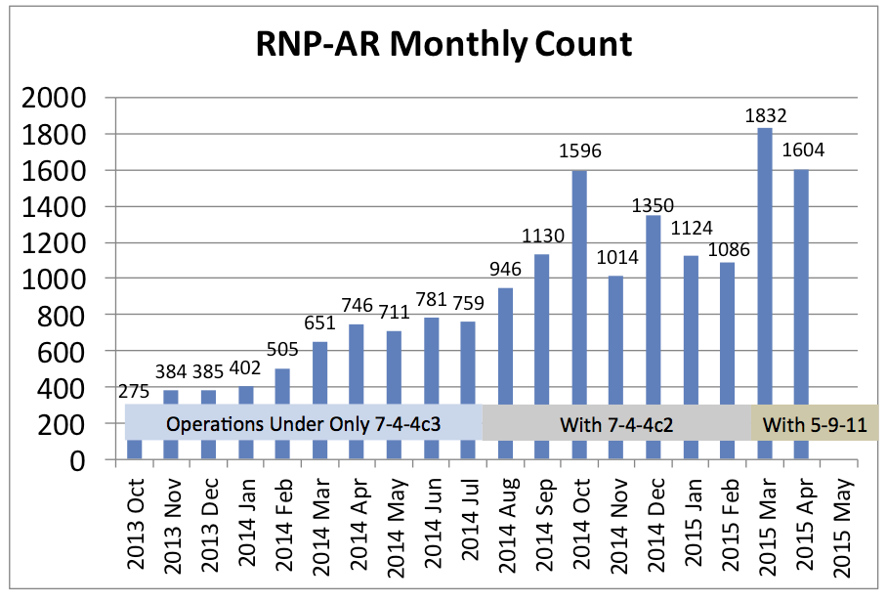
DEN RNP AR Approach Utilization
Three Significant Rule Changes Allowing the Expanded Use of RNP-AR
  Oct 7, 2013 - Para 7-4-4c3 30 degree intercept rule satisfied by RNP-AR (> 4300 ft RW)
  Aug 22, 2014 - Para 7-4-4c2 30 degree intercept rule satisfied by RNP-AR (2500-4300 ft RW)
  Mar 12, 2015 – Para 5-9-11a1 Waiver Issued for Widely-Spaced EoR Ops
In Denver, EoR (RNP-ARs) From Both Downwinds Simultaneously “is not an IMC Only Operation,” Instead, “it is an All Weather Operation”

Slide 23
EoR’s Part in the PBN Vision
EoR is a new PBN application based on existing RNP navigation specifications with additional utility in the air traffic toolbox
EoR will contribute to NextGen trajectory based flow management through repeatable and predictable PBN paths
EoR procedures reduce track miles and enhance arrival slot predictability aiding in more efficient gate to gate management

Slide 24
EoR Plan Ahead
Conduct Concept Validation Analyses of SEA and DEN Implementations
Initiate National Standard Change for Widely Spaced EoR Operations with RNP AR
Complete Safety Analysis of Less Restrictive RNP Approaches (non-AR) for Simultaneous Independent Duals
Select Initial Implementation Site

Slide 25
Summary
PBN Programs have Implemented Over 5,000 Procedures and Routes at Nearly 2,000 Airports
Current Implementation Processes Focus on Quality and Value Rather than Quantity
Program Initiatives are Delivering New Capabilities and Benefits with PBN

